Slide 1
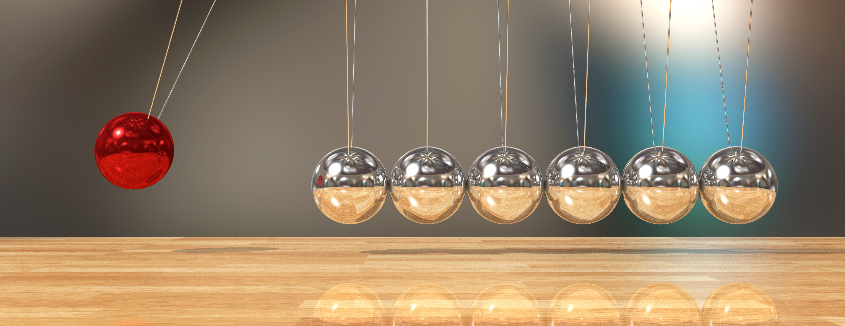
Impulse Momentum Collisions
NJ-OER TOPIC-8

Slide 2
Learning Outcomes
Recognize the definition of momentum and impulse and their vector nature Identify the mathematical quantities which effect the momentum and be able to calculate momentum from mass and velocity Define impulse, indicate its units and relate its significance to a collision Determine a momentum change and a total system momentum and to state what momentum conservation means

Slide 3
Concepts
F = Average force I = impulse t = impact time v = velocity m = mass P = momentum F=Force as vector P=Momentum as vector | Fx = x component of the force Fy= y component of the force Px = x component of the momentum Py = y component of the momentum Pi = initial momentum Pf = final momentum P = initial momentum P' = final momentum Σ = sum

Slide 4
Units
SI Units Force is in Newton’s “N” Energy is in Joules “J” Impulse is in “N.s” Momentum is in kg m/s ; no special units Mass is in kilogram “kg” Angle is in degrees or radian

Slide 5
Formulas
I = F t Pfx – Pix = Fx t Pfy – Piy = Fy t Collisions/Systems: Conservation of momentum ∑Pi=∑Pf ∑P=∑P' ∑Pix=∑Pfx ∑Px=∑Px' ∑Piy=∑Pfy ∑Py=∑Px' ∑Pi=∑Pf m1 v1i + m2 v2i = m1 v1f + m2 v2f m1 v1i +m2 v2i = mtotal vf 100% inelastic ∑KEi=∑KEf v1i + v1f = v2i + v2f Elastic collisions only

Slide 6
DISCLAIMER
ALL ONE OBJECT PROBLEMS ARE IMPULSE PROBLEM
MOMENTUM IS NOT CONSERVED DUE TO THE EXTERNAL FORCE

Slide 7
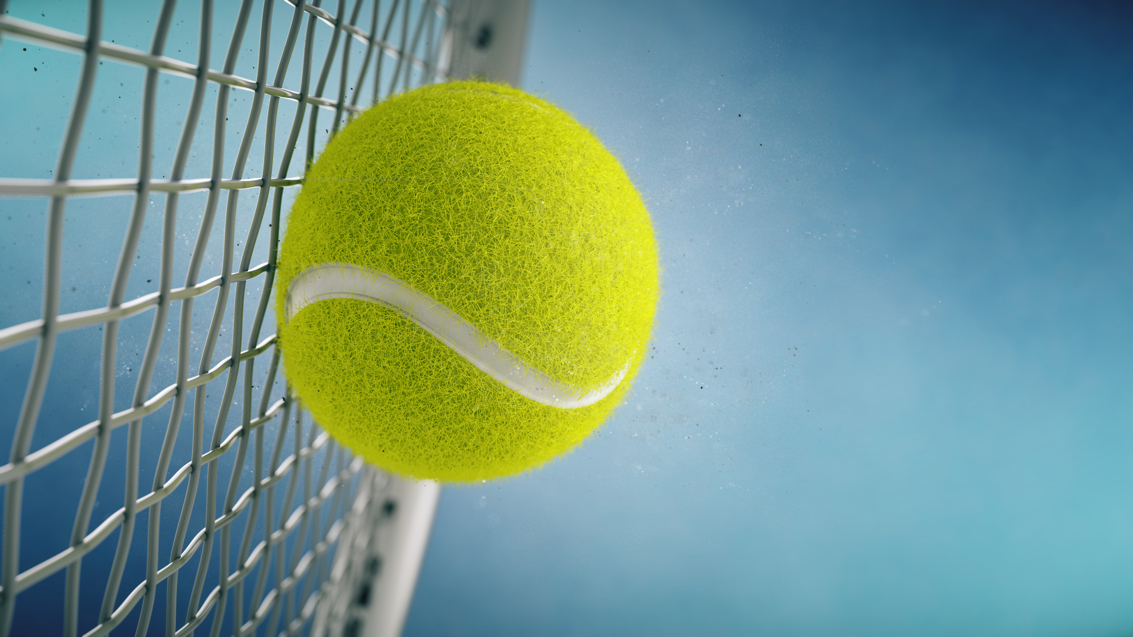
1 Object 1-D Impulse
Q: A 0.060-kg tennis ball is coming to a tennis player with a speed of 42 m/s. It is struck by the racket with an average force of 77 N, which results in a speed of 28 m/s in the opposite direction from the original velocity. What is the interaction time between the ball and the racket?
Before (initial) During After(final)
m = 0.60 kg vi= - 42 m/s F = 77 N t=? m=0.60 kg vf = 28 m/s
Pi = 0.60 (-42) = -25.2 kgm/s I = 77 t Pf = 0.60 (28) = 16.8 kgm/s
Pf-Pi = I

Slide 8
1 Object 1-D Impulse
Solution Numerically
Before (initial) During After(final)
m = 0.60 kg vi= - 42 m/s F = 77 N t=? m=0.60 kg vf = 28 m/s
Notes:
Pi = 0.60 (-42) = -25.2 kgm/s I = 77 t Pf = 0.60 (28) = 16.8 kgm/s
I = Pf - Pi
77 t = 16.8 -(-25.2)
t = 42/77 = 0.55 s

Slide 9
1 Object 2-D Impulse
Solution Symbolically
Before (initial) During After(final)
m = 0.60 kg vi= - 42 m/s F = 77 N t=? m=0.60 kg vf = 28 m/s
Pi =m vi I = F t Pf = m vf
I = Pf - Pi
F t = m vi – m vf
t = (m vi – m vf)/F
Notes:
t=[ 60(kg) 28(m/s)-60(kg)(-42)(m/s)/[77(N)] t=0.55s

Slide 10
1 Object 2-D Impulse
Q: A 0.0600-kg tennis ball is coming to a tennis player with a speed of 42.0m/s towards West. It is struck by the racket diagonally which results in a speed of 36.0 m/s now making 30.0 degrees with the incoming direction going 30.0 degrees North of East. What was the x-component of the Force (Fx) if the interaction time between the ball and the racket is 0.400 seconds?
Before (initial) During After(final)
m = 0.60 kg vix= - 42 m/s viy=0 Fx = ? Fy=? t= 0.40s m=0.60 kg vfx = 36 cos(30) vfy=36 sin(30)
Notes:
Pix = 0.60 (-42) = -25.2 kgm/s Ix= Fx t Pfx = 0.60 (36) (0.866)= 16.8 kgm/s
Piy = 0 Iy= Fy t Pfx-Pix=Fx t 42=Fx (0.4) Fx=10.5N

Slide 11
TYPICAL 1-D COLLISIONS

Slide 12
GENERAL FORMULA FOR THE COLLISIONS

Slide 13
1-D Collisions
Q: A 1200 kg red car moving with 18.0 m/s East hits a 1000 kg grey car moving with 12.0 m/s East. After the collision, the red car slows down to 15.0 m/s due to the impact. What is the final velocity of the grey car assuming that there is no external force
Notes:
SOLUTION
Vf= 15.6 m/s

Slide 14
COLLISION TYPES
1-D Perfectly inelastic collisions
1-D Inelastic collisions
1-D Elastic collisions
2-D Collision (Elastic-Inelastic-Perfectly Elastic)
In all collisions total momentum is conserved and net impulse is zero if there are no external effect.
Pi (total) = Pf(total) or Ptotal = P'total
ELASTIC COLLISIONS ALSO CONSERVES ENERGY
Ei = Ef of E=E' which leads to v1f+v1i=v2f+v2i or v1'+v1 = v2'+v2
FOR 2-D Collisions components of the momentum is conserved
Pix(total) = Pfx(total) and Piy(total)=Pfy(total)

Slide 15
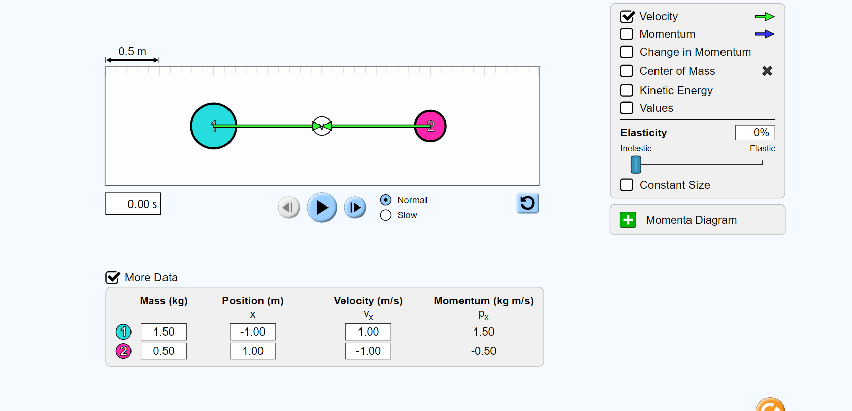
1-D Collision with Simulation-Inelastic
Open the link
https://phet.colorado.edu/sims/html/collision-lab/latest/collision-lab_en.html
Obtain the following image for the initial collision.
Make sure you change the values for Mass and velocity, The position is not important. Use the slider to obtain 0% elasticity. Hit the start button and verify your answer.
Q1) A 1.5 kg mass going East with 1.0 m/s collides with a 0.5 kg mass going West with 1.0 m/s. Find their final velocity after the perfectly inelastic collision.
Formula: Pi(total) = m(total) Vf
Notes:
ANSWER: vf = 0.50 m/s
v1' = v2' = 0.50 m/s

Slide 16
1-D Collision with Simulation-Inelastic
A 0.7kg mass moving East with 2.6 m/s collides with a stationary 0.6 kg mass in a perfectly inelastic collision
A 0.8 kg mass moving with 2m/s collides with a 0.4 kg mass moving in the same direction
M1=1.5kg V1i=2.0 m/s
M2=2.0 kg V2i = -1.2 m/s
d) M1=2.2 kg V1i= 0 m/s
M2=2.0 kg V2i = -1.2 m/s
https://phet.colorado.edu/sims/html/collision-lab/latest/collision-lab_en.html
Q) Use the same link and perform the same simulation with the quantities given on the right. Use the formula below to estimate Vf.
Compare your calculations with the result of the simulation
Pi(total) = m(total) Vf
All collisions are perfectly inelastic

Slide 17
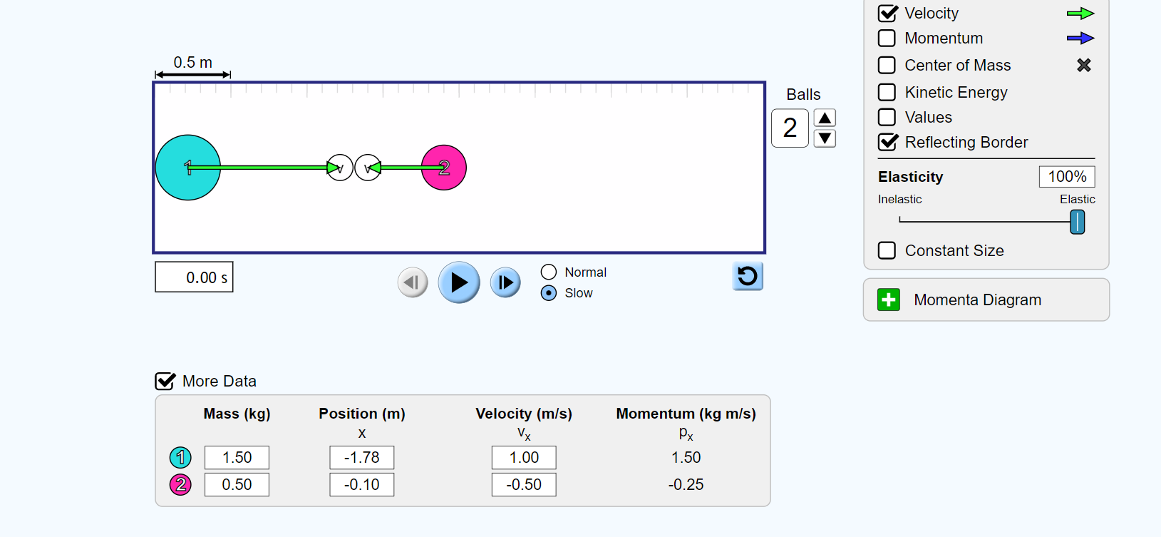
1-D Collision with Simulation-Elastic
Open the link
https://phet.colorado.edu/sims/html/collision-lab/latest/collision-lab_en.html
Obtain the following image for the initial collision.
Make sure you change the values for Mass and velocity, The position is not important. Use the slider to obtain 100% elasticity. Hit the start button and verify your answer.
Q3) A 1.5 kg mass going East with 1.0 m/s collides with a 0.5 kg mass going West with 1.0 m/s. Find their final velocity after the elastic collision. Use
Pi(total) = m1 v1'+m2 v2'
v1'-v1 = v2' - v2
This is a system of equations
v1' and v2' are the unknowns
Notes:
Answer: v1'=-1.0 m/s v2'=1.0 m/s

Slide 18
1-D Collision with Simulation-Inelastic
A 0.7kg mass moving East with 2.6 m/s collides with a stationary 0.6 kg mass in an elastic collision
A 0.8 kg mass moving with 2.0 m/s collides elastically with a 0.4 kg mass moving in the same direction with 0.2 m/s
M1=1.5kg V1=2.0 m/s
M2=2.0 kg V2 = -1.2 m/s
d) M1=2.2 kg V1= 0 m/s
M2=2.0 kg V2 = -1.2 m/s
https://phet.colorado.edu/sims/html/collision-lab/latest/collision-lab_en.htmlQ) Use the same link and perform the same simulation with the quantities given on the right. Use the formula below to estimate v1' and v2'. All collisions are elastic.
Compare your calculations with the result of the simulation. Use
Pi(total) = m1 v1' + m2 v2'
v1' -v1 = v2' -v2

Slide 19
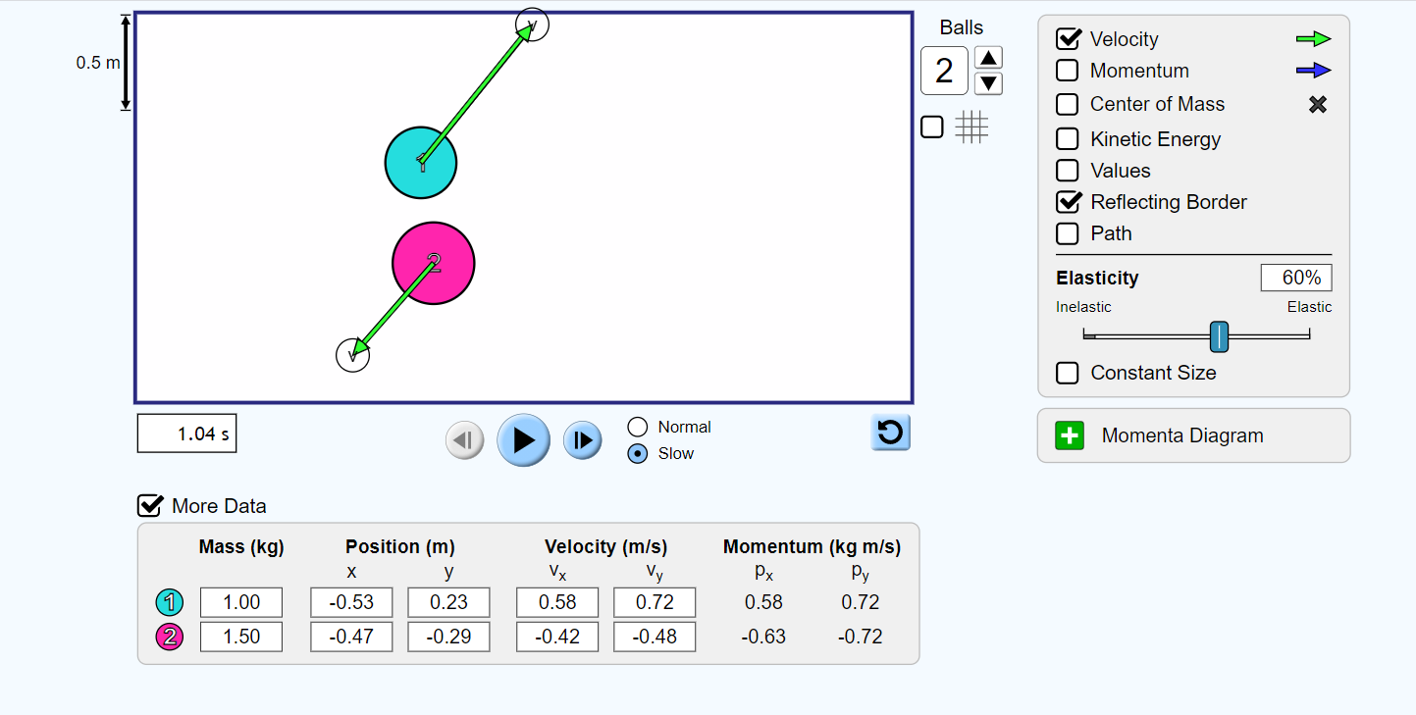
GLANCING COLLISIONS
A typical 2-D glancing collision is demonstrated on the right.
Top image is the initial and the bottom is the final.
Components of the momentum is conserved
If you know the mass, the initial velocities, and the final velocity of one of the objects, you can predict the final velocity of the second object

Slide 20
GLANCING COLLISIONS
Q5 A 1.0 kg mass going East with 1.3 m/s collides with a 1.2 kg mass going West with 1.0 m/s. After the collision 1.0 kg mass moves diagonally with a speed of 1.0 m/s making 45 degrees with the x-axis. Since
vx=v cos(theta) vy=v sin(theta)
Find v1x' and v1y'
Calculate v2x' and v2y'
Px(total) = Px'(total)
Py(total)=Py'(total)
Px(total) = 0.1 kg m/s initial x-momentum
Py(total)= 0.0 kg m/s initial y-momentum
Notes:
ANSWER: v2x'=-0.51m/s v2y'=-0.58m/s

Slide 21
GLANCING COLLISIONS
Q A 1.0 kg mass going East with 1.3 m/s collides with a 1.2 kg mass going West with 1.0 m/s. Change the impact angle by dragging one of the masses up or down. Makes sure it results in a glancing collision.
Use the simulation and observe the final velocity of the 1.0 kg mass. Use v1x' and v1y' and the conservation of momentum, predict v2x' and v2y'
Compare your results
Change the numbers and come up with your own questions.
Px(total) = Px'(total)
Py(total)=Py'(total)
Px(total) = 0.1 kg m/s initial x-momentum
Py(total)= 0.0 kg m/s initial y-momentum

Slide 22
REFERENCES
Slide 1: Adobe id= 126428104 Balancing ball Newton's cradle pendulum By G3D Studio
Slide 7-8-9-10: Adobe id= 245877214 Tennis racket hits tennis ball. Closeup on blue background- 3d rendering By Sashkin
Slide 11: Adobe id= 170139266 Conservation of Momentum. Collision Before and After By fancytapis
Slide 12: Adobe id= 251203372 Experiment - the law of conservation of the momentum of the body, the sum of the impulses of the two trolleys before the collision is equal to the momentum of these trolleys after the ... By ser68orion
Slide 13: Open Stax College Physics online textbook
Slide 15-17-18-19-20-21 Screenshot from PhET Interactive Simulations University of Colorado Boulder https://phet.colorado.edu

